Slide 1
Course Wrap-Up

Slide 2

React

Slide 3

Components
Render UI
Event management
Internal state updates

Slide 4




Modular design advantages
Simple to test and debug
Component composition
Complex UIs with readable code

Slide 5

Class versus function components
Access to state
Hooks introduced in V16.8

Slide 6

Class versus function components
Function components :
Performance
Simplified code
Readable
Easy to reason about

Slide 7
Props
Contains the component’s data
Cannot change data in child nodes
Parent
Children
Children
Children

Slide 8
Component state access
Class
• this. State
• this. SetState()
Function
• Hooks
• UseState

Slide 9
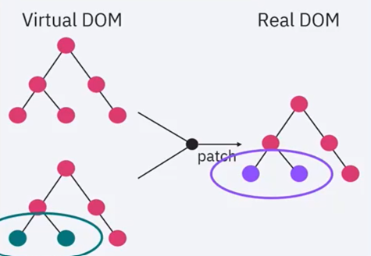
Virtual DOM
No need for DOM
manipulation

Slide 10


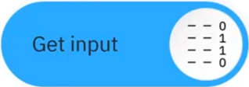
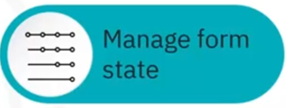

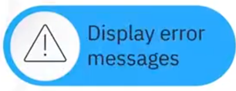
Forms and validation

Slide 11




Redux

Slide 12

Reference materials
• Glossaries
• Cheat sheets
• Quickly refer to
vocabulary and code

Slide 13

Software developer programs
Multiple programs
available
Two to six months

Slide 14
Available programs
Full-stack with JavaScript
Full-stack with Python and
JavaScript
Front-end development
Mobile a development

Slide 15

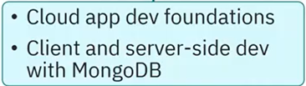
Available programs

Slide 16

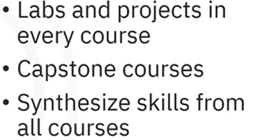
Labs and project

Slide 17


